Slide 1

Shopify App Analysis

Slide 2
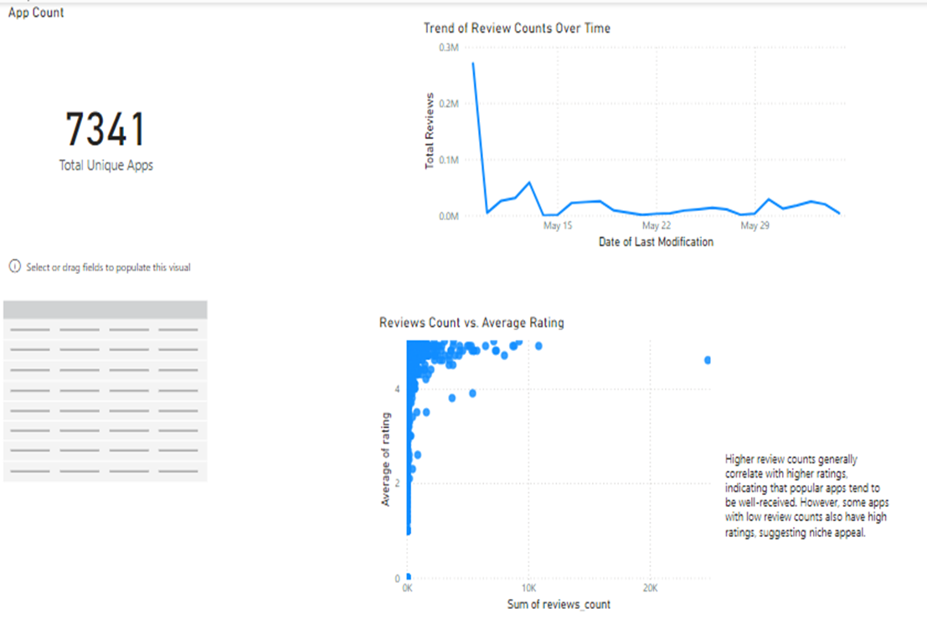
Insights and Strategies from App Review Analysis

Slide 3

Insights and Strategies from App Review Analysis (cont.)
Findings:
Total Unique Apps: There are 7,341 unique apps analyzed.
Review Trends: Review counts have seen a significant spike early in the observed timeframe, followed by a notable drop and consistent low activity afterward.
Reviews vs. Ratings: Apps with higher review counts generally have higher average ratings, indicating that popular apps are well-received. However, there are also apps with fewer reviews but high ratings, suggesting niche appeal.

Slide 4
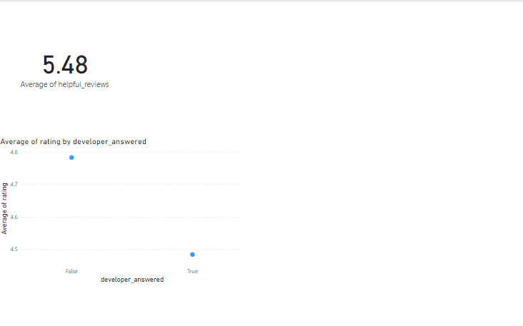
Developer Responses and Review Impact

Slide 5
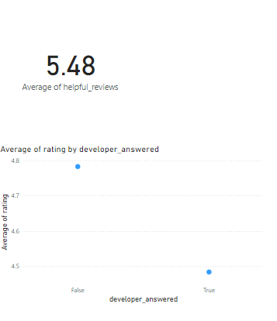
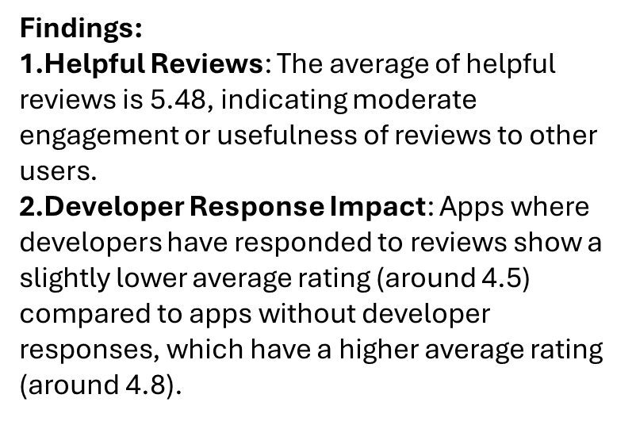
Developer Responses and Review Impact (cont.)

Slide 6
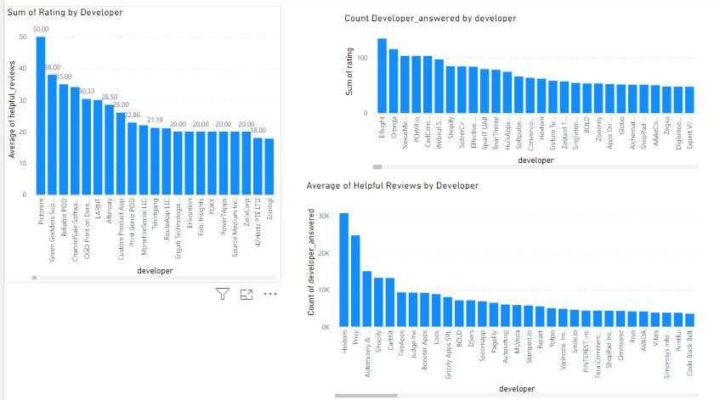
Developer Performance Analysis.

Slide 7
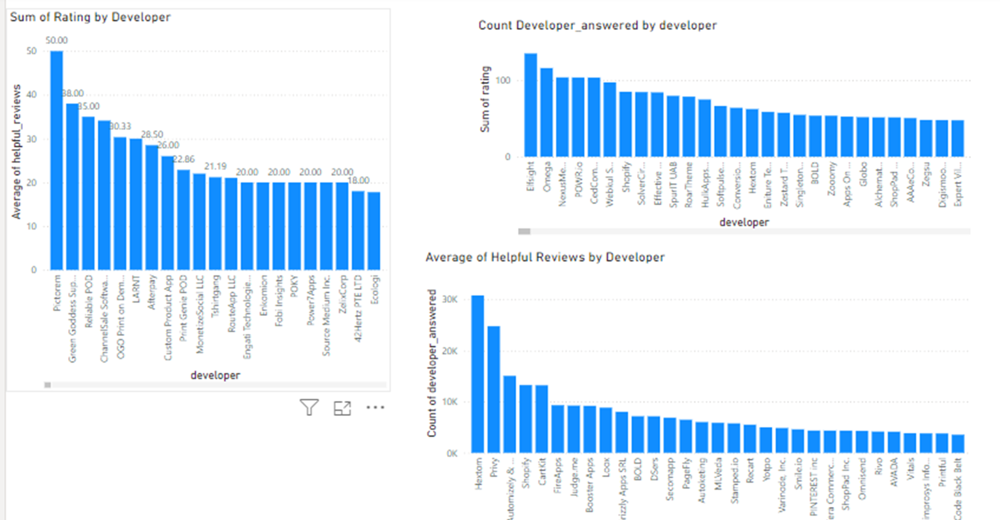
Developer Performance Analysis (cont.)
Active Developers: Certain developers, such as Elsevier and Foresman, lead in both counts and averages of helpful reviews, reflecting quality engagement. Opportunities for Improvement: Other developers with lower counts or averages might require efforts to improve their responses or visibility.
Findings:
Average of Helpful Reviews by Developer (Bottom): This section highlights the average helpful reviews attributed to each developer. Developers such as Elsevier and Hawkthorn stand out with a higher average, suggesting better or more impactful feedback on user queries.
Findings:
The sum of Helpful Reviews by Developer (Top Left):
Displays the total helpful reviews for each developer.
The highest number of helpful reviews is observed for developers like Foresman, demonstrating strong engagement or quality responses.
Findings:
Count of Developers Answered by Developer (Top Right): This shows the number of ratings or answers provided by each developer. Developers like Elsevier and Foresman rank high, indicating significant activity or coverage of user queries.

Slide 8
Conclusions and Recommendations
Insights and Strategies from App Review Analysis
Conclusions:
The initial spike in reviews may indicate a specific event or campaign that caused a surge in user activity. High review counts often align with good app ratings, reinforcing the value of user feedback as a quality indicator. Niche apps with high ratings and low reviews could be under-promoted or catering to a smaller but satisfied audience.
Recommendations:
Investigate the reason behind the early review spike to replicate similar engagement strategies.
Focus on promoting high-rated niche apps to expand their user base and review count.
Encourage consistent user feedback for less popular apps through engagement campaigns or incentives to enhance visibility and ratings.

Slide 9
Conclusions and Recommendations
Developer Responses and Review Impact
Recommendations:
Investigate the context of lower ratings in apps where developers have responded to ensure timely and effective resolutions to user concerns.
Encourage users to provide helpful reviews by offering incentives or making the review process more seamless.
Focus on proactive measures to improve app performance and user satisfaction to minimize the need for critical feedback that requires developer intervention.
Conclusions:
The initial spike in reviews may indicate a specific event or campaign that caused a surge in user activity. High review counts often align with good app ratings, reinforcing the value of user feedback as a quality indicator. Niche apps with high ratings and low reviews could be under-promoted or catering to a smaller but satisfied audience.

Slide 10
Conclusions and Recommendations
Developer Performance Analysis.
Conclusions:
Top Performers: Developers such as Elsevier, Foresman, and Hawkthorn excel in multiple metrics, showing high activity levels and quality engagement.
Underperforming Developers: Some developers exhibit lower helpful review counts and averages, which may indicate limited activity or less impactful responses.
Engagement Disparity: A significant performance gap exists between the highest and lowest performers, indicating a need for targeted interventions.
Recommendations:
Reward High Performers: Recognize and incentivize developers like Elsevier and Foresman to sustain and further improve their contributions.
Enhance Support for Low Performers: Provide training, tools, or guidelines to developers with lower helpful review metrics to boost their effectiveness.
Monitor and Encourage Consistency: Implement regular performance tracking and feedback mechanisms to ensure consistent engagement across all developers.
Focus on Impact: Emphasize the quality of responses, not just quantity, to ensure meaningful user interactions and improve overall satisfaction.

